Slide 1


90s Race to the 20s Data Nexus
By,
Team- PLEO
Enjoy the game & chase your Dreams.
Dreams do come True
- Sachin Tendulkar

Slide 2
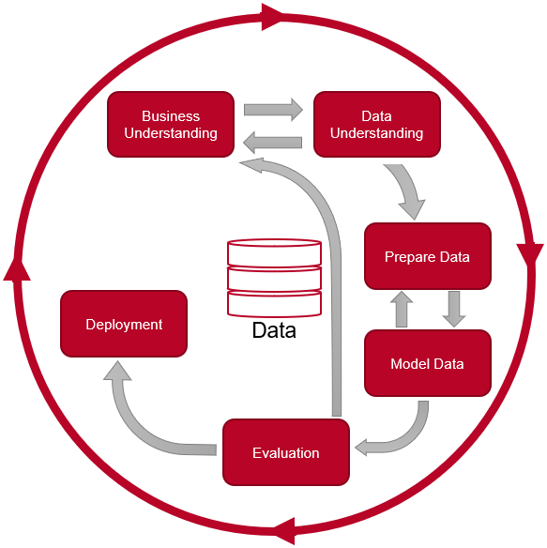
Our Approach
CRoss Industry Standard Process for Data Mining Framework
The Global Cricket Market Size was estimated at USD 330.36 Mn in 2021 and is projected to reach USD 374.4 Mn by 2028, exhibiting a CAGR of 1.8% during the forecast period.
To introduce a team creation system that allows players to use virtual characteristics in a customized team.
Rows: 10938; Columns: 80
Data Preparation:
Treating Null Values
Replacing Missing Values
Feature Selection
Exploratory Data Analysis
(CRISP-DM)

Slide 3
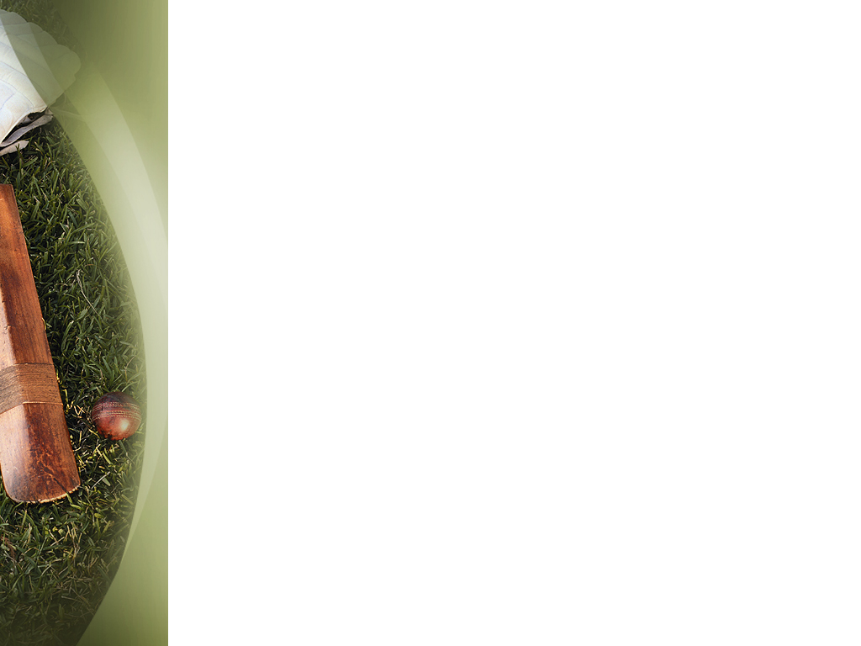
What we Explored in the Dataset
Drilled down with the dimension of 3721 x 80
Removed the Null Values and Inspected the Duplicates.

Slide 4
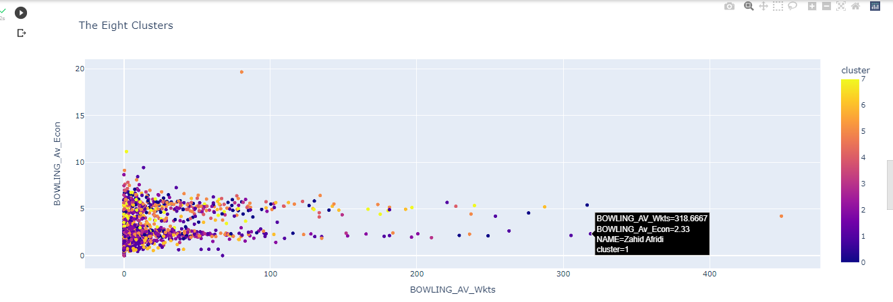
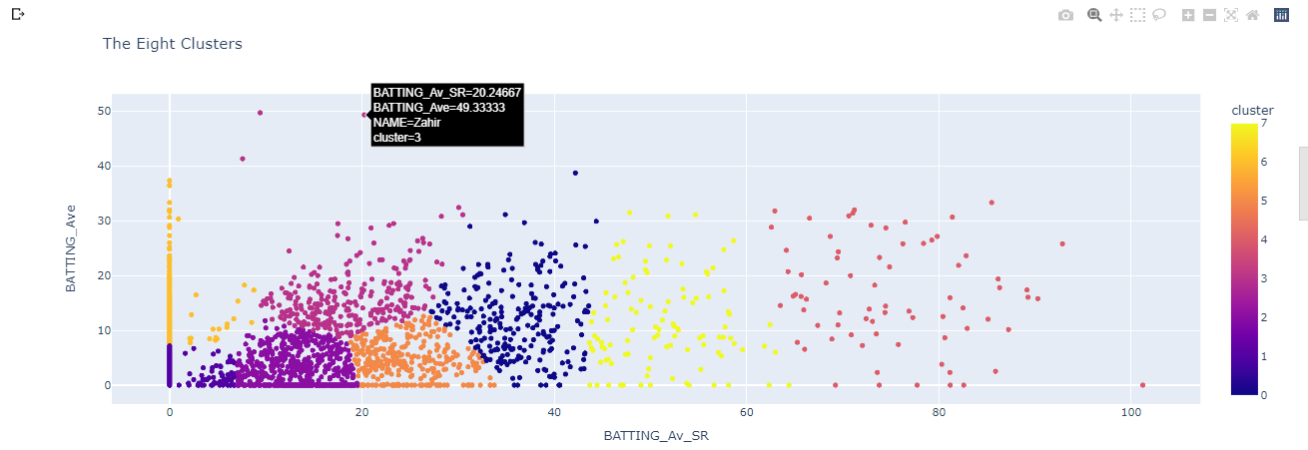
Our Recommendation Using ML Model- KNN in Python
For Best Bowlers
For Best Batsmen
Best Batsmen | Wicket Keeper | Best All rounder | Bowler
Henry Montgomery | Zahoor | Geoff Millman | R Merland
H Lowe |  | Mohammad Ali | Michael Morgan
Geoff Miller |  |  | Zeeshan
Noel Morgan |  |  | K van Tonder

Slide 5
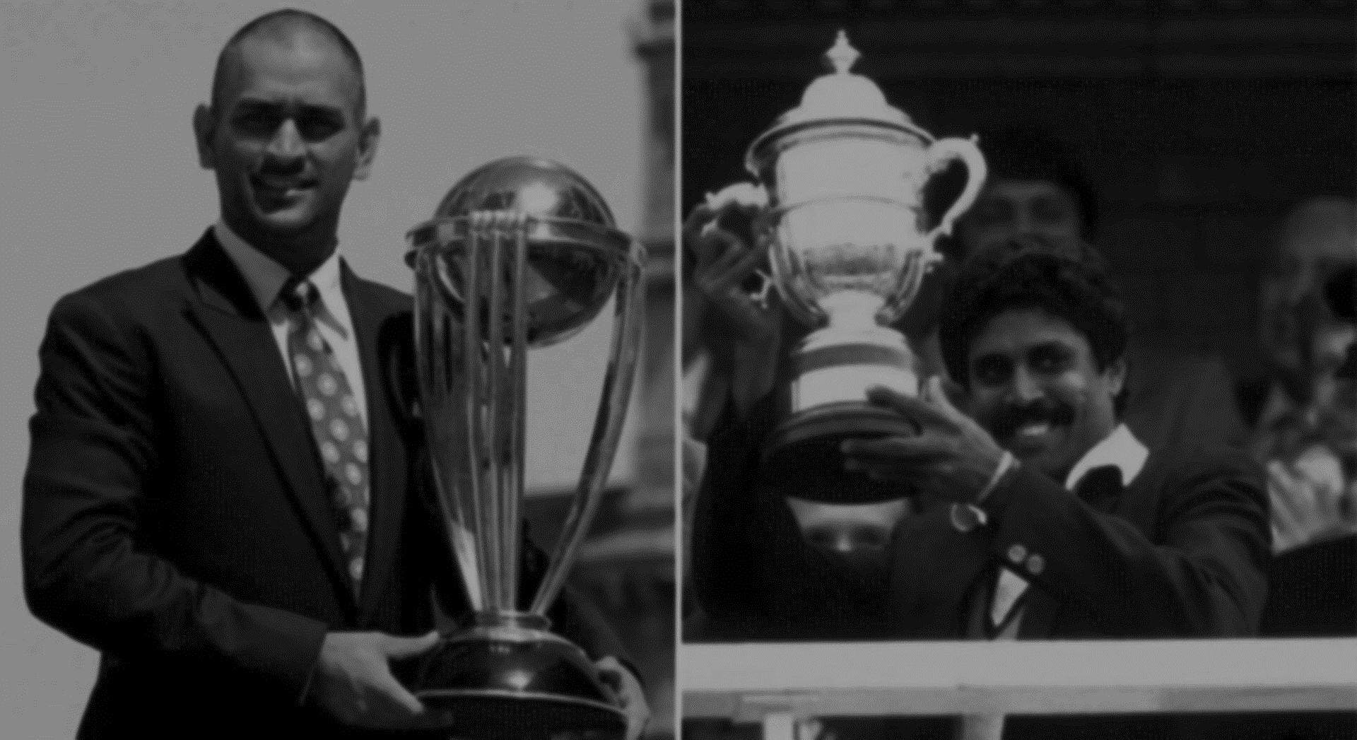
A Comparative Approach
THANK YOU!
We are Now Open for Questions….
ronit.kumar@mba.christuniversity.in
hemanath.kumar@mba.christuniversity.in

